Slide 1

Introduction to PsychToolbox in MATLAB
Psych 599, Summer 2016
Jonas Kaplan, Ph.D.
University of Southern California

Slide 2
Course details
Instructor: Jonas Kaplan, Ph.D.
Office: DNI 251
Course website: https://blackboard.usc.edu
Grade: weekly assignments plus final project

Slide 3
What is Psychtoolbox?
Psychophysics Toolbox is a set of Matlab functions for behavioral research
It runs on Mac, Windows, and Linux
Allows precise control of your screen, audio, collection of responses
Controls low-level system events using a high-level language (Matlab)
Freely available
http://psychtoolbox.org

Slide 4
What is Matlab?
Matrix Laboratory
“MATLAB® is a high-level language and interactive environment for numerical computation, visualization, and programming. Using MATLAB, you can analyze data, develop algorithms, and create models and applications. The language, tools, and built-in math functions enable you to explore multiple approaches and reach a solution faster than with spreadsheets or traditional programming languages, such as C/C++ or Java™.
You can use MATLAB for a range of applications, including signal processing and communications, image and video processing, control systems, test and measurement, computational finance, and computational biology. More than a million engineers and scientists in industry and academia use MATLAB, the language of technical computing.

Slide 5
Becoming a programmer: why?
Increase your freedom
Increase your scientific value
Enjoyment
Exercise your logical mind

Slide 6


Slide 7

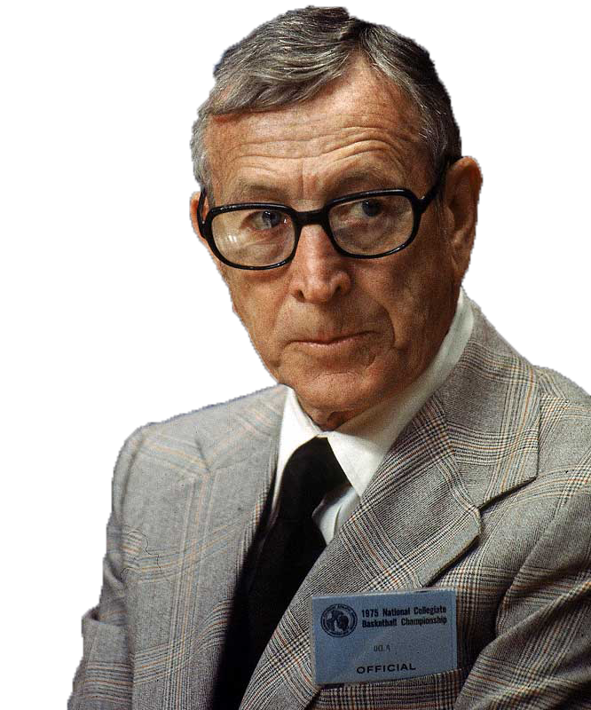
If you don't have time to do it right, when will you have time to do it over?
Make it work!

Slide 8
Coding philosophy
The “Tim Gunn principle”
  There are many different ways to make things work.
  The prettiest way is not always the most desirable.
  Top priority is that your script does what you want it to do.
The “John Wooden principle”
  Good coding practices are important
  Assume you will remember nothing next time you look at your code
  Assume someone else will be using your code
  Assume your script will at some point move to another computer

Slide 9
The process of programming
Programming is not a linear process
Lots of trial and error
Problem solving, detective work, deductive reasoning
Debugging may take longer than initial writing. Enjoy it!

Slide 10
Learning how to program
Learn how to learn
Practice
Proficiency is not in being able to do everything you need to do, but knowing how to figure out what you need to do when you don’t know

Slide 11
Imposter Syndrome
From codeahoy.com: “Do experienced programmers use Google frequently?”
The resounding answer is YES, experienced (and good) programmers use Google… a lot. In fact, one might argue they use it more than the beginners. Using Google doesn’t make them bad programmers or imply that they cannot code without Google. In fact, truth is quite the opposite: Google is an essential part of their software development toolkit and they know when and how to use it.
A big reason to use Google is that it is hard to remember all those minor details and nuances especially when you are programming in multiple languages and using dozens of frameworks. As Einstein said:
“Never memorize something that you can look up.” - Albert Einstein
Aside from that, good programmers also know that they cannot be the first one to have encountered a problem. They use Google to research possible solutions, carefully evaluating the results and consciously separating the wheat from the chaff; they don’t blindly follow or copy-paste any solution they come across. Expert programmers are also paranoid, living in self-doubt and questioning their competence. Whenever their spidey senses start tingling, they know they may be going the wrong hole; they rely on Google on validate their logic.

Slide 12
Structure of the course
Each four hour period will be divided into lecture and exercise
Each week you will complete a programming assignment
Final exam is to build a complete experiment

Slide 13
Calendar
Week 1:
Introduction to
MATLAB
Week 2:
MATLAB
programming
Week 3:
Controlling
the screen
Week 4:
Sound and
multimedia
Week 5:
Responses and
experimental design
Week 6:
Reading your data;
Putting it all
together

Slide 14
Getting the software and looking around

Slide 15
Getting the software
Get MATLAB: http://software.usc.edu
  Current USC version: 2013b
  Current Mathworks version: 2016a
Get Psychtoolbox: http://psychtoolbox.org
May also need:
  Gstreamer SDK to play video:
  http://www.gstreamer.com
  (make sure to check all the boxes when you install)

Slide 16
Installing Psychtoolbox
http://psychtoolbox.org/download/
Make sure you have all the prerequisites
Download the “DownloadPsychtoolbox.m” script and run it
Restart Matlab
Type
      PsychtoolboxVersion
  to check your installation

Slide 17
Tour
Knowing your way around the UI
Getting back to default layout
Customizing layout

Slide 18
The Command Window and
Command History
Typing in commands
moving through history
re-executing commands

Slide 19
The file browser
Moving around through the folder hierarchy
Command line tools for navigation
cd change directory
ls list directory contents
. current directory
.. parent directory

Slide 20
The workspace and variable editor
Settings variables:
x = 3
Clearing variables:
clear x
clear all

Slide 21
Matlab settings
Customizations
PATH

Slide 22
Basics of the MATLAB language

Slide 23
Getting help
help function
doc function
pop-up help
>> help sin
sin Sine of argument in radians.
sin(X) is the sine of the elements of X.
See also asin, sind.
Reference page in Help browser
doc sin

Slide 24
Scripts
Anything you type into the workspace can also be run from a script
“.m” files are just saved lists of matlab commands
functions
  encapsulated blocks of code that operate on variables in their own independent workspaces

Slide 25
The Editor
Comments
Syntax highlighting
Code folding

Slide 26
Variables
What is a variable?
Variable names and conventions

Slide 27
Variable types
Numbers
double: floating point number like
3.24
integer: no decimal places
345

Slide 28
Vectors and matrices
Vectors are like lists
a = [1,2,3,4,5]
Matrices are like lists of lists
a = [ 1,3,5,7;
2,4,6,8 ]
Matrices can have many dimensions

Slide 29
Creating vectors
>> a = [1 2 3 4 5]
a =
1 2 3 4 5
>> a = [1,2,3,4,5]
a =
1 2 3 4 5
>> a = [1:5]
a =
1 2 3 4 5
Also try:
x = [1:0.1:10]

Slide 30
Creating matrices
>> a = [1 2 3; 4 5 6]
a =
1 2 3
4 5 6
>> a = [1 2 3; 4 5 6; 7 8 9]
a =
1 2 3
4 5 6
7 8 9

Slide 31
Creating matrices
>> ones(3)
ans =
1 1 1
1 1 1
1 1 1
>> ones(2,3)
ans =
1 1 1
1 1 1
>> zeros(3,4)
ans =
0 0 0 0
0 0 0 0
0 0 0 0
(rows,columns)

Slide 32
Creating matrices
>> rand(3)
ans =
0.8147 0.9134 0.2785
0.9058 0.6324 0.5469
0.1270 0.0975 0.9575
>> nan(4)
ans =
NaN NaN NaN NaN
NaN NaN NaN NaN
NaN NaN NaN NaN
NaN NaN NaN NaN
NaN = “Not a Number”

Slide 33
Describing matrices
size() will tell you the dimensions of a matrix
length() will tell you the length of a vector

Slide 34
Accessing elements
>> a = [0:4]
a =
0 1 2 3 4
>> a(2)
ans =
1
>> b = [1,2,3;4,5,6;7,8,9]
b =
1 2 3
4 5 6
7 8 9
>> b(2,3)
ans =
6

Slide 35
Accessing elements
>> b(1:3,1)
ans =
1
4
7
>> b(1,:)
ans =
1 2 3
>> a([1,2,4])
ans =
0 1 3

Slide 36
Accessing elements
>> a(end)
ans =
4
>> a(end-1)
ans =
3

Slide 37
Vector math
Adding a constant to each element in a vector
Adding two vectors
>> a = [1 2 3]
a =
1 2 3
>> a + 1
ans =
2 3 4
>> b = [5 1 5]
b =
5 1 5
>> a + b
ans =
6 3 8

Slide 38
Vector multiplication
The * sign refers to matrix multiplication:
>> a = [1 2 3]
a =
1 2 3
>> b = [2 2 4]
b =
2 2 4
>> a * b
Error using *
Inner matrix dimensions must agree.
>> b = b'
b =
2
2
4
>> a * b
ans =
18
transposing a matrix:
use ‘ to transpose, i.e. flip rows and columns

Slide 39
Vector multiplication
The .* sign refers to element-wise multiplication:
>> a = [1 2 3]
a =
1 2 3
>> b = [2 2 4]
b =
2 2 4
>> a .* b
ans =
2 4 12
>> a * 4
ans =
4 8 12
>> a .* 4
ans =
4 8 12

Slide 40
Operators
Element-wise operators:
.* multiplication
./ division
.^ exponentiation
Many other functions work element-wise, e.g.:
>> a = [1 4 9]
a =
1 4 9
>> sqrt(a)
ans =
1 2 3

Slide 41
Working with strings
Strings in Matlab are vectors of characters
Always use single quotes to define strings
>> name = 'Jonas'
name =
Jonas
>> name(1)
ans =
J
>> name(1:3)
ans =
Jon

Slide 42
Working with strings
>> x = 'abc'
x =
abc
>> y = 'def'
y =
def
>> x + y
ans =
197 199 201
>> double('a')
ans =
97
>> double('d')
ans =
100
>> char(97)
ans =
a

Slide 43
Working with strings
>> strcat(x,y)
ans =
abcdef
>> newstring = strcat(x,y)
newstring =
abcdef
>> newstring = strcat(x,y);
>>
results stored in new variable
semicolon suppresses output of results

Slide 44
Formatting strings
What do we typically do with strings?
  Printing out messages to the workspace
  Printing out data or messages to files
  Using them as stimuli in an experiment
  Using them as filenames, codes, or identifiers

Slide 45
Formatting strings
Several ways to print a string out to the workspace:
  type the name of the variable w/o a trailing semicolon
  disp() is almost the same as above, except it does not print out the variable name
  fprintf() is for formatting text and printing out to a file or other device, such as the workspace
  sprintf() is for formatting text in order to create new string variables

Slide 46
Working with strings
>> name = 'Fred';
>> name
name =
Fred
>> disp(name)
Fred
>> fprintf(name)
Fred>> sprintf(name)
ans =
Fred
notice the lack of newline character

Slide 47
Formatting strings
fprintf() is a very powerful command for formatting strings, combining them, and printing them out
>> help fprintf
fprintf Write formatted data to text file.
fprintf(FID, FORMAT, A, ...) applies the FORMAT to all elements of
array A and any additional array arguments in column order, and writes
the data to a text file. FID is an integer file identifier. Obtain
FID from FOPEN, or set it to 1 (for standard output, the screen) or 2
(standard error). fprintf uses the encoding scheme specified in the
call to FOPEN.
fprintf(FORMAT, A, ...) formats data and displays the results on the
screen.

Slide 48
Formatting strings
>> employee = 'Fred';
>> age = 32;
>> score = 88.432;
>> fprintf('Employee: %s is %d years old and scored %f',employee,age,score);
Employee: Fred is 32 years old and scored 88.432000>>
These symbols that start with % are substitution points (‘conversion characters’). Matlab will insert the subsequent variables into the text, in order. The number of variables listed must match the number of conversion characters.
%s string
%d integer/digit
%i integer/digit
%f floating point number
%c single character

Slide 49
Formatting strings
>> >> fprintf('%s\t%d\n',employee,age)
Fred 32
There are many special characters to control formatting that begin with the backslash:
\t tab
\n newline
\v vertical tab

Slide 50
Working with numbers in strings
>> fprintf('Score: %f\n',score);
Score: 88.432000
>> fprintf('Score: %.2f\n',score);
Score: 88.43
>> fprintf('Score: %.0f\n',score);
Score: 88
>> fprintf('Score: %.5f\n',score);
Score: 88.43200
Specifies the number of decimal places in a floating point number
>> fprintf('Age: %d\n',age)
Age: 32
>> fprintf('Age: %.4d\n',age)
Age: 0032
Or the number of total digits in an integer

Slide 51
Special characters
>> fprintf ('Score was %.2f%%\n',score)
Score was 88.43%
>> fprintf('Name is ''%s''\n',name)
Name is 'Fred'
If you want to print the actual character instead of invoking its special meaning:
‘’ to print a single-quote
%% to print a percent sign

Slide 52
Creating string variables
>> help sprintf
sprintf Write formatted data to string.
STR = sprintf(FORMAT, A, ...) applies the FORMAT to all elements of
array A and any additional array arguments in column order, and returns
the results to string STR.
[STR, ERRMSG] = sprintf(FORMAT, A, ...) returns an error message when
the operation is unsuccessful. Otherwise, ERRMSG is empty.
sprintf is the same as FPRINTF except that it returns the data in a
MATLAB string rather than writing to a file.

Slide 53
Creating string variables
>> subject = 'SXF32';
>> logfileName = sprintf('data_%s.txt',subject);
>> logfileName
logfileName =
data_SXF32.txt
Make your variable names as informative as possible. Someone reading your code should know what a variable contains by looking at its name. That person might be Future You or a colleague.

Slide 54
Collections of strings
Lists of strings
Take note!
Curly braces -> Cell array
Straight braces -> regular array
>> names = ['Jonas','Fred','John']
names =
JonasFredJohn
Introducing cell arrays
>> names = {'Jonas','Fred','John'}
names =
'Jonas' 'Fred' 'John'

Slide 56
Cell arrays
Cell arrays can mix and match data types.
Each cell is its own self-contained variable
Cell arrays can be arranged in multiple dimensions just like matrices

Slide 57


Using cell arrays
>> mycell = {'hello',4,'goodbye',543.43}
mycell =
'hello' [4] 'goodbye' [543.4300]
>> mycell = {[1:5],[6:10]}
mycell =
[1x5 double] [1x5 double]
>> mycell(1)
ans =
[1x5 double]
>> mycell{1}
ans =
1 2 3 4 5
access the cells themselves
access the contents of the cells

Slide 58
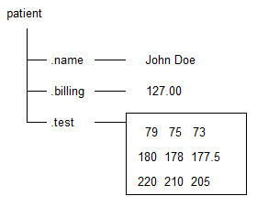
Structures
Structures can be used to organize and group information
>> patient.name = 'John Doe';
>> patient.billing = 127.00;
>> patient.test = [79, 75, 73; 180, 178, 177.5; 220, 210, 205];
>> patient
patient =
name: 'John Doe'
billing: 127
test: [3x3 double]

Slide 59
Arrays of structures
>> patient(2).name = ’Jane Doe';
>> patient(2).billing = 156.00;
>> patient(2).test = [71 73, 55; 101, 22, 22; 242, 211, 205];
>> patient
patient =
1x2 struct array with fields:
name
billing
test
>> patient(1)
ans =
name: 'John Doe'
billing: 127
test: [3x3 double]

Slide 60
Saving variables
save() to save the workspace to disk
load() to load a .mat file that contains variables from disk
clear() to remove a variable from memory
who, whos to list variables in memory

Slide 61
Saving variables
>> who
Your variables are:
age employee mycell patient score
>> whos
Name Size Bytes Class Attributes
age 1x1 8 double
employee 1x4 8 char
mycell 1x2 304 cell
patient 1x2 1056 struct
score 1x1 8 double

Slide 62
Saving variables
>> save('matlabclass1')
>> clear
>> who
>>
>> load('matlabclass1')
>> who
Your variables are:
age employee mycell patient score
>> save('onevar','patient')
>> clear
>> who
>> load('onevar')
>> who
Your variables are:
patient

Slide 63
Writing scripts

Slide 64
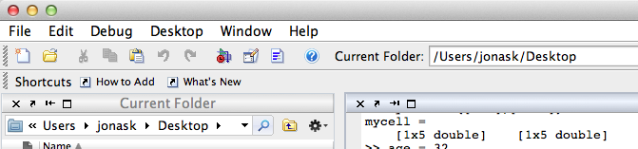
Creating a script
create new blank document

Slide 65
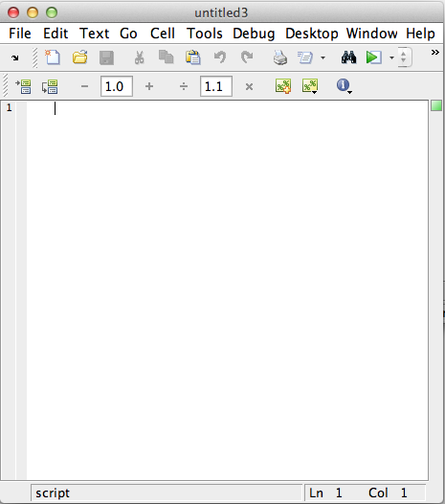
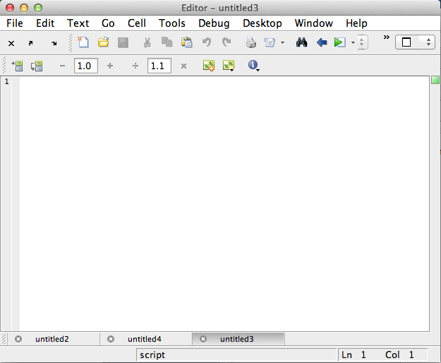
Editor options
Docking and undocking tabs

Slide 66
Your first script
% My first script
x = 5;
y = 6;
z = x + y
Save script as “myFirst.m”
>> myFirst
z =
11

Slide 67
Functions

Slide 68
What is a function?
A function is a self-contained piece of code that accomplishes a specific function
It may take in certain variables (parameters) and return results

Slide 69

Function declarations
All functions must be declared, that is, introduced in the proper way.
code folding
result of the function
name of the function
parameters passed to the function
OUT
IN

Slide 70
Function declarations
Functions may return no variables:
function printAName(name)
%Not very exciting. Just prints a name.
fprintf(‘The name is: %s\n’,name);
Or several:
function [avg,biggest,smallest] = getSomeStats(x)
%Return some statistics on vector x
avg = mean(x);
biggest= max(x);
smallest = min(x);

Slide 71
Variable scope
Variables only exist within a certain “scope”
Variables defined in a function only exist within that function

Slide 72
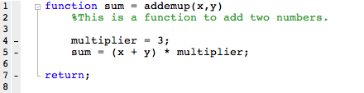
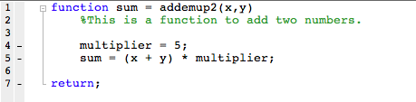
Variable scope
>> addemup(1,1)
ans =
6
>> addemup2(1,1)
ans =
10

Slide 73
Coding style
Your code needs to be readable by humans as well as by machines
Never trust yourself to remember anything. You will always forget. Just because something appears obvious now does not mean it will in the future, or to someone else.
Use comments to explain what you are doing in English.

Slide 74
Coding style
In a collaborative laboratory setting your code is not just for you:
  you need to write to allow other people to update and change your code for their purposes
  you need to write your code to be as flexible as possible. this means we will expect the code to be transported to other machines, and other environments

Slide 75


Coding style
ist= 10;
sst= 4;
r= [1,2];
ist = ist/fr;
sst = sst/fr;
%set up standard presentation parameters
instructionScreenTime = 10; %how long the instructions will stay on, in seconds
stimulusScreenTime = 4; %how long the stimulus will stay on, in seconds
acceptableResponses = [1,2]; %which responses buttons the subject may press
%convert times from seconds into frames
instructionScreenTime = instructionScreenTime/frameRate;
stimulusScreenTime = stimulusScreenTime/frameRate;

Slide 76
Coding style
Make your comments informative
%add two to the instruction screen time
instructionScreenTime = instructionScreenTime + 2; %here we are adding two
%add time to the instruction screen time to account for
%the additional time needed by this subject population
instructionScreenTime = instructionScreenTime + 2;

Slide 77
Coding style
Matlab does not enforce spacing and indentation, but you should for code readability
Keep blocks of code clearly demarcated

Slide 78
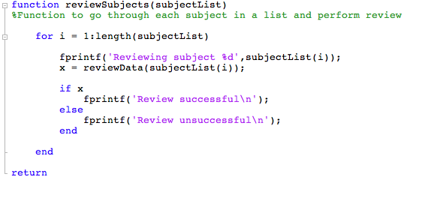
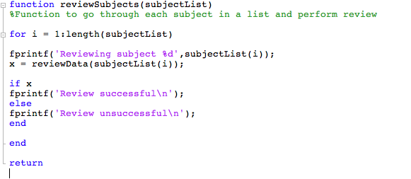
Coding style

Slide 80
Week #1 assignment
Write a function named “yourInitials_week1()”
The function should take two inputs:
1) a string containing the subject’s code
2) a vector of 5 scores
The function should return two values:
1) the mean of the 5 scores, after removing the lowest one
2) the standard error of the mean of the 5 scores after removing the lowest one
The function should also do the following when run:
1) print the following line to the screen:
“Working on subject XXXX…” where XXXX is the subject code
2) plot a bar graph with the 5 scores

